Slide 1
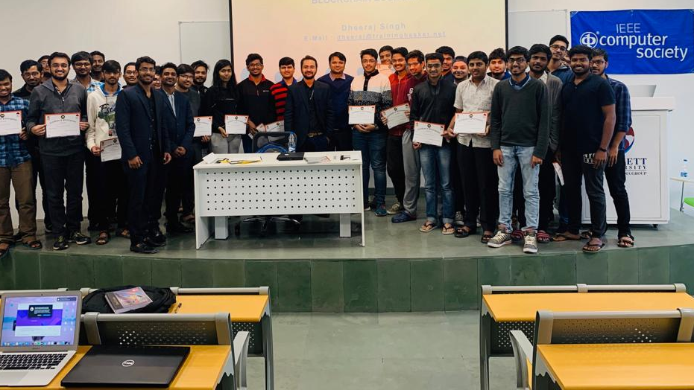

Project Title
ECSE205L - Spring 2020
Team member names
Enrolment numbers
Batch

Slide 2
Contents
Introduction
Problem
Solution
Software Requirements
Tech utilized

Slide 3
Introduction
What is the general scenario in the present time and how audience will get a feel of the situation so far. Similar or close solutions available by other companies which will be your benchmark.

Slide 4
Problem
What is the issue with the current system that motivated you to develop a software solution? What problem you are addressing or what gap you are trying to fill.

Slide 5
Solution
Describe the software solution you are going to provide that will solve the current problem. What will be the innovation. Why you think it is doable in the given time frame.

Slide 6
Software Requirements
The ATM shall be in two languages. English and Hindi.

Slide 7
Tech/Resources utilized <(datasets, H/W, tools etc.)>
JAVA
C++

Slide 8
Feedback <from friends/ seniors/ parents/ industry/ teachers etc. (Give by name)>

Slide 9
Acknowledgement
Any faculty member who is involved in your project/helping could be acknowledged here.

Slide 10
Thank You

